Slide 1
Customizing Hibernate with Annotations (and more)
Scott Faria

Slide 2
Why?
Automate common or error-prone behaviors in your Hibernate-driven application.
Inject behavior in existing applications (audit logging, etc.).
Overcome shortcomings in Hibernate and/or your RDBMS (Seriously, Oracle, why is there no bool type?).

Slide 3
How?
There’s a few ways of customizing the runtime behavior of Hibernate:
Callback methods.
Entity listeners.
Custom Types.
Interceptors.

Slide 4
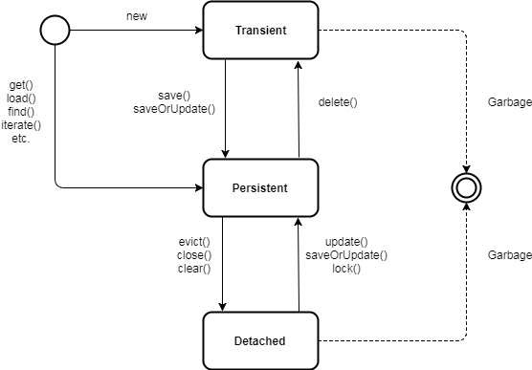
But first a quick word on the hibernate lifecycle…

Slide 5
Hibernate Lifecycle
The methods for customization here act on objects as they move from transient -> persistent and persistent -> transient.
Allows us to modify state before the SQL gets generated and executed and before queries are transformed into results.

Slide 6
Callback Methods
The simplest form of hooking into the hibernate lifecycle.
Consist of annotated methods declared on the entity object.

Slide 7
Callback Methods
Type | Description
@PrePersist | Executed before the entity manager persist operation is actually executed or cascaded. This call is synchronous with the persist operation.
@PreRemove | Executed before the entity manager remove operation is actually executed or cascaded. This call is synchronous with the remove operation.
@PostPersist | Executed after the entity manager persist operation is actually executed or cascaded. This call is invoked after the database INSERT is executed.
@PostRemove | Executed after the entity manager remove operation is actually executed or cascaded. This call is synchronous with the remove operation.
@PreUpdate | Executed before the database UPDATE operation.
@PostUpdate | Executed after the database UPDATE operation.
@PostLoad | Executed after an entity has been loaded into the current persistence context or an entity has been refreshed.

Slide 8
Entity Listeners
Evolution of Callback methods.
Allows for extraction and reuse of callback methods.

Slide 9
Custom Types
Implement org.hibernate.usertype.UserType.
Defines custom types for fields in an Entity.
Useful for simple value conversions.
String -> Enum.
String -> Boolean.
etc.

Slide 10

Interceptors

Slide 11
Interceptors
Set on the EntityManagerFactory and applies to all functions performed on the EntityManager.
Allows for more complicated and deeper hooking into the Hibernate lifecycle.

Slide 12
Thanks!
View code and slides @
https://github.com/sfaria/hibernate_customization_demo

